Slide 1

LARAVEL
QUERY BUILDER
Notes:
le parsing json de la request et de la réponse (du coup ausi j'ai vu, c'est specifique aux POST/PUT)
req.body
accessoirement la gestion des erreur dans le catch

Slide 2

# OBJECTIVES FOR TODAY
QUERY BUILDER FUNCTION
Notes:
https://laravel.com/docs/9.x/queries

Slide 3



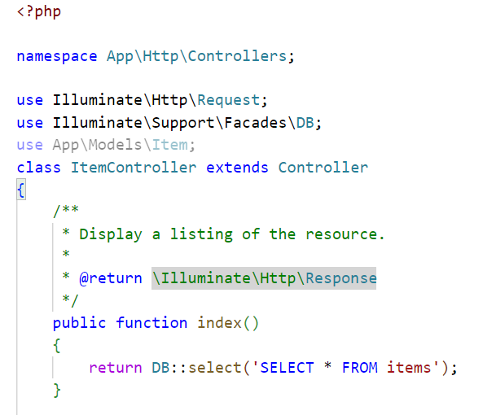
EXPLAIN
# Query Builder
05 MNI
Laravel's database query builder provides a convenient, fluent interface to creating and running database queries.
What is Query Builder?
Why we use it?
We need DB Class for use Query Builder
Example
Ex. Get all data from items table

Slide 4
EXPLAIN
# Query Builder
05 MIN
# SELECT QUERY BASIC
DB::selectOne(‘SELECT * FROM table-name’);
DB::select (‘SELECT * FROM table-name’);
# SELECT QUERY BASIC WITH WHERE CONDITION
Not secure way
MySQL Prepared Statements
Example
DB::select (‘SELECT * FROM table-name’ WHERE id = 1’);
PDO Prepared Statements
DB::select (‘SELECT * FROM table-name’ WHERE id = ?’, [1]);
DB::select (‘SELECT * FROM table-name’ WHERE id = :id’, [‘id’ => 2]);

Slide 5


PRACTICE
Activity 1
10 MIN
INDIV
Use artisan command
Create : posts table, PostController, Post model and PostFactory
Table columns: title and description
Insert 50 data using faker library
Use query builder to display all posts in function getAllPosts()
Use query buider to display only post where id = 10 in fuction getOnePost()

Slide 6
EXPLAIN
# Query Builder
05 MIN
MySQL Prepared Statements
# CRUD BASIC
DB::select (‘SELECT * FROM table-name’);
DB::insert (‘INSERT INTO table-name (col1, col2, ..) VALUES (?, ?, ..)’, [value1, value2,…]);
Example
DB::update (‘UPDATE table-name SET col1 = ?, col2 =?, .. WHERE id = ?’, [value1, value2,…]);
DB::delete (‘DELETE FROM table-name WHERE id = ?’ [value]);

Slide 7
EXPLAIN
# Query Builder
05 MIN
PDO Prepared Statements
# CRUD BASIC
DB::select (‘SELECT * FROM table-name’);
DB::insert (‘INSERT INTO table-name (col1, col2, ..) VALUES (:key1, :key2, ..)’,
[‘key1’ => value1, ‘key2’ => valu2,…]);
Example
DB::update (‘UPDATE table-name SET col1 = :key1, col2 =:key2, .. WHERE id = :id’,
[‘key1’ => value1, ‘key2’ => valu2, ‘id’ => value3…]);
DB::delete (‘DELETE FROM table-name WHERE id = :id’ [‘id’ => value]);

Slide 8
PRACTICE
Activity 2
10 MIN
INDIV
Lets CRUD one post that has id = 51
Using MySQL prepare statement
Using PDO prepare statement

Slide 9
EXPLAIN
# Query Builder
05 MIN
Get only title and description
# TABLE QUERY BASIC
DB::table(‘table-name’)->get();
DB::table (‘table-name’)->select(‘title’, ‘description’)->get();
# TABLE QUERY BASIC WITH WHERE CONDITION
Get only that equal id 10
DB::table (‘table-name’)->where(‘id’, ‘>’, 10)->get();
Example
DB::table (‘table-name’)->where(‘id’, 10)->get();
DB::table (‘table-name’)->where(‘id’, ‘=’, 10)->get();

Slide 10
EXPLAIN
# Query Builder
05 MNI
orderByDesc()
whereBetween()
skip() / take()
where()
find()
select()
orderBy()
whereIn()
inRandomOrder()
value()
whereNotBetween()
first()
count()
sum()
min()
avg()
max()

Slide 11
EXPLAIN
# Query Builder
05 MNI
where()
select()
first()
find()
value()
Example
DB::table (‘table-name’)->where(‘col’, ‘compare sign’ ,value)->get();
DB::table (‘table-name’)->select(col1, col2..)->get();
<, >, =, >=, <=
DB::table (‘table-name’)->first();
DB::table (‘table-name’)->find(value);
DB::table (‘table-name’)->value(column);
Notes:
https://laravel.com/docs/5.0/schema
https://www.codegrepper.com/code-examples/php/laravel+data+types

Slide 12
EXPLAIN
# Query Builder
05 MNI
whereBetween()
whereNotBetween()
whereIn()
Example
DB::table (‘table-name’)-> whereBetween(col1, [value1, value2])->get();
DB::table (‘table-name’)-> whereNotBetween(col1, [value1, value2])->get();
DB::table (‘table-name’)-> whereIn(col1, [value1, value2, …])->get();
Notes:
https://laravel.com/docs/5.0/schema
https://www.codegrepper.com/code-examples/php/laravel+data+types

Slide 13
EXPLAIN
# Query Builder
05 MNI
orderByDesc()
orderBy()
inRandomOrder()
Example
DB::table (‘table-name’)-> orderBy (col)->get();
DB::table (‘table-name’)-> orderBy(col, ‘asc or desc’])->get();
DB::table (‘table-name’)-> orderByDesc(col)->get();
DB::table (‘table-name’)-> inRandomOrder()->get();
Notes:
https://laravel.com/docs/5.0/schema
https://www.codegrepper.com/code-examples/php/laravel+data+types

Slide 14
EXPLAIN
# Query Builder
05 MNI
count()
min()
max()
sum()
avg()
Example
DB::table (‘table-name’)-> count (col);
DB::table (‘table-name’)-> max(col);
DB::table (‘table-name’)-> min(col);
DB::table (‘table-name’)-> sum(col);
DB::table (‘table-name’)-> avg(col);
Notes:
https://laravel.com/docs/5.0/schema
https://www.codegrepper.com/code-examples/php/laravel+data+types

Slide 15
EXPLAIN
# Query Builder
05 MNI
skip() / take()
Example
DB::table (‘table-name’)-> skip (value)->take(number)->get();
Notes:
https://laravel.com/docs/5.0/schema
https://www.codegrepper.com/code-examples/php/laravel+data+types

Slide 16
# OBJECTIVES FOR TODAY

